Slide 1

Baptist Health DevOps Terraform Workshop
Day 2 – Introduction Terraform and GitHub

Slide 2
This Week’s Schedule
Day 1 – Introduction to DevOps, VS Code
Day 2 – Introduction to GitHub & Terraform
Day 3 – Advanced Terraform and BHS Terraform

Slide 3
Why Terraform?

Slide 4

Terraform is the lingua franca and common workflow for teams provisioning resources across public and private cloud
Source: Hashicorp. (Accessed July 2020). Unlocking the Cloud Operating Model
Notes:
Lingua franca = common language

Slide 5
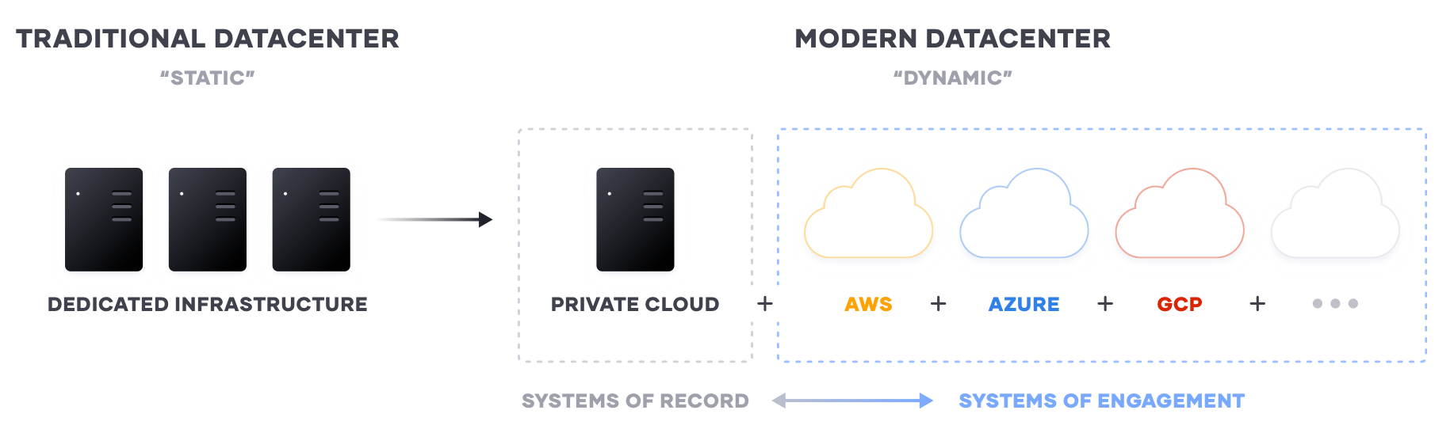
IT generational transition
to the Modern Datacenter
Image Source: Hashicorp. (Accessed July 2020). Unlocking the Cloud Operating Model. https://www.datocms-assets.com/2885/1591034885-hashicorpcomwhitepaperv9digital.pdf
Notes:
Systems of engagement underpin the software and products that drive value and respond to customer demand quickly
As the number of platforms and providers has increased, so has the number of ways to develop and interact with those same systems.
As organizations grow and transition out of the traditional datacenter, they must plan effectively and efficiently for how they will interact with these many service providers on various platforms

Slide 6





Provision
Secure
On-demand infrastructure
Scale
Globally distributed
Maintain static infrastructure
Low-trust/Zero-trust environment
Identity-based security
Disrupts traditional perimeter-based security
The Cloud Operating Model seeks to address the challenges IT faces as business transitions from static to dynamic infrastructure through a common set of actions that apply to the modern datacenter
Connect
Run
Dynamic networking layer
Service discovery
Cluster orchestration
Dynamic/elastic scale
Applications and the environment in which they run are packaged and scheduled
Notes:
The Cloud Operating model…
Provision on-demand, globally with scalability
Secure with zero-trust, identity-based controls
Connect on a dynamic networking layer and maintain and foster service discovery
Run with orchestration, as well as dynamic and elastic scalabilty

Slide 7

The Cloud Operating Model
HashiCorp Stack
Provision with Terraform
Secure with Vault
Connect with Consul
Run with Nomad
Notes:
To address the Cloud Operating Model…
As you increase in maturity provisioning with Terraform, you may consider implementing Vault for secret management, or Consul for network security as well as discovering and access control for services.

Slide 8
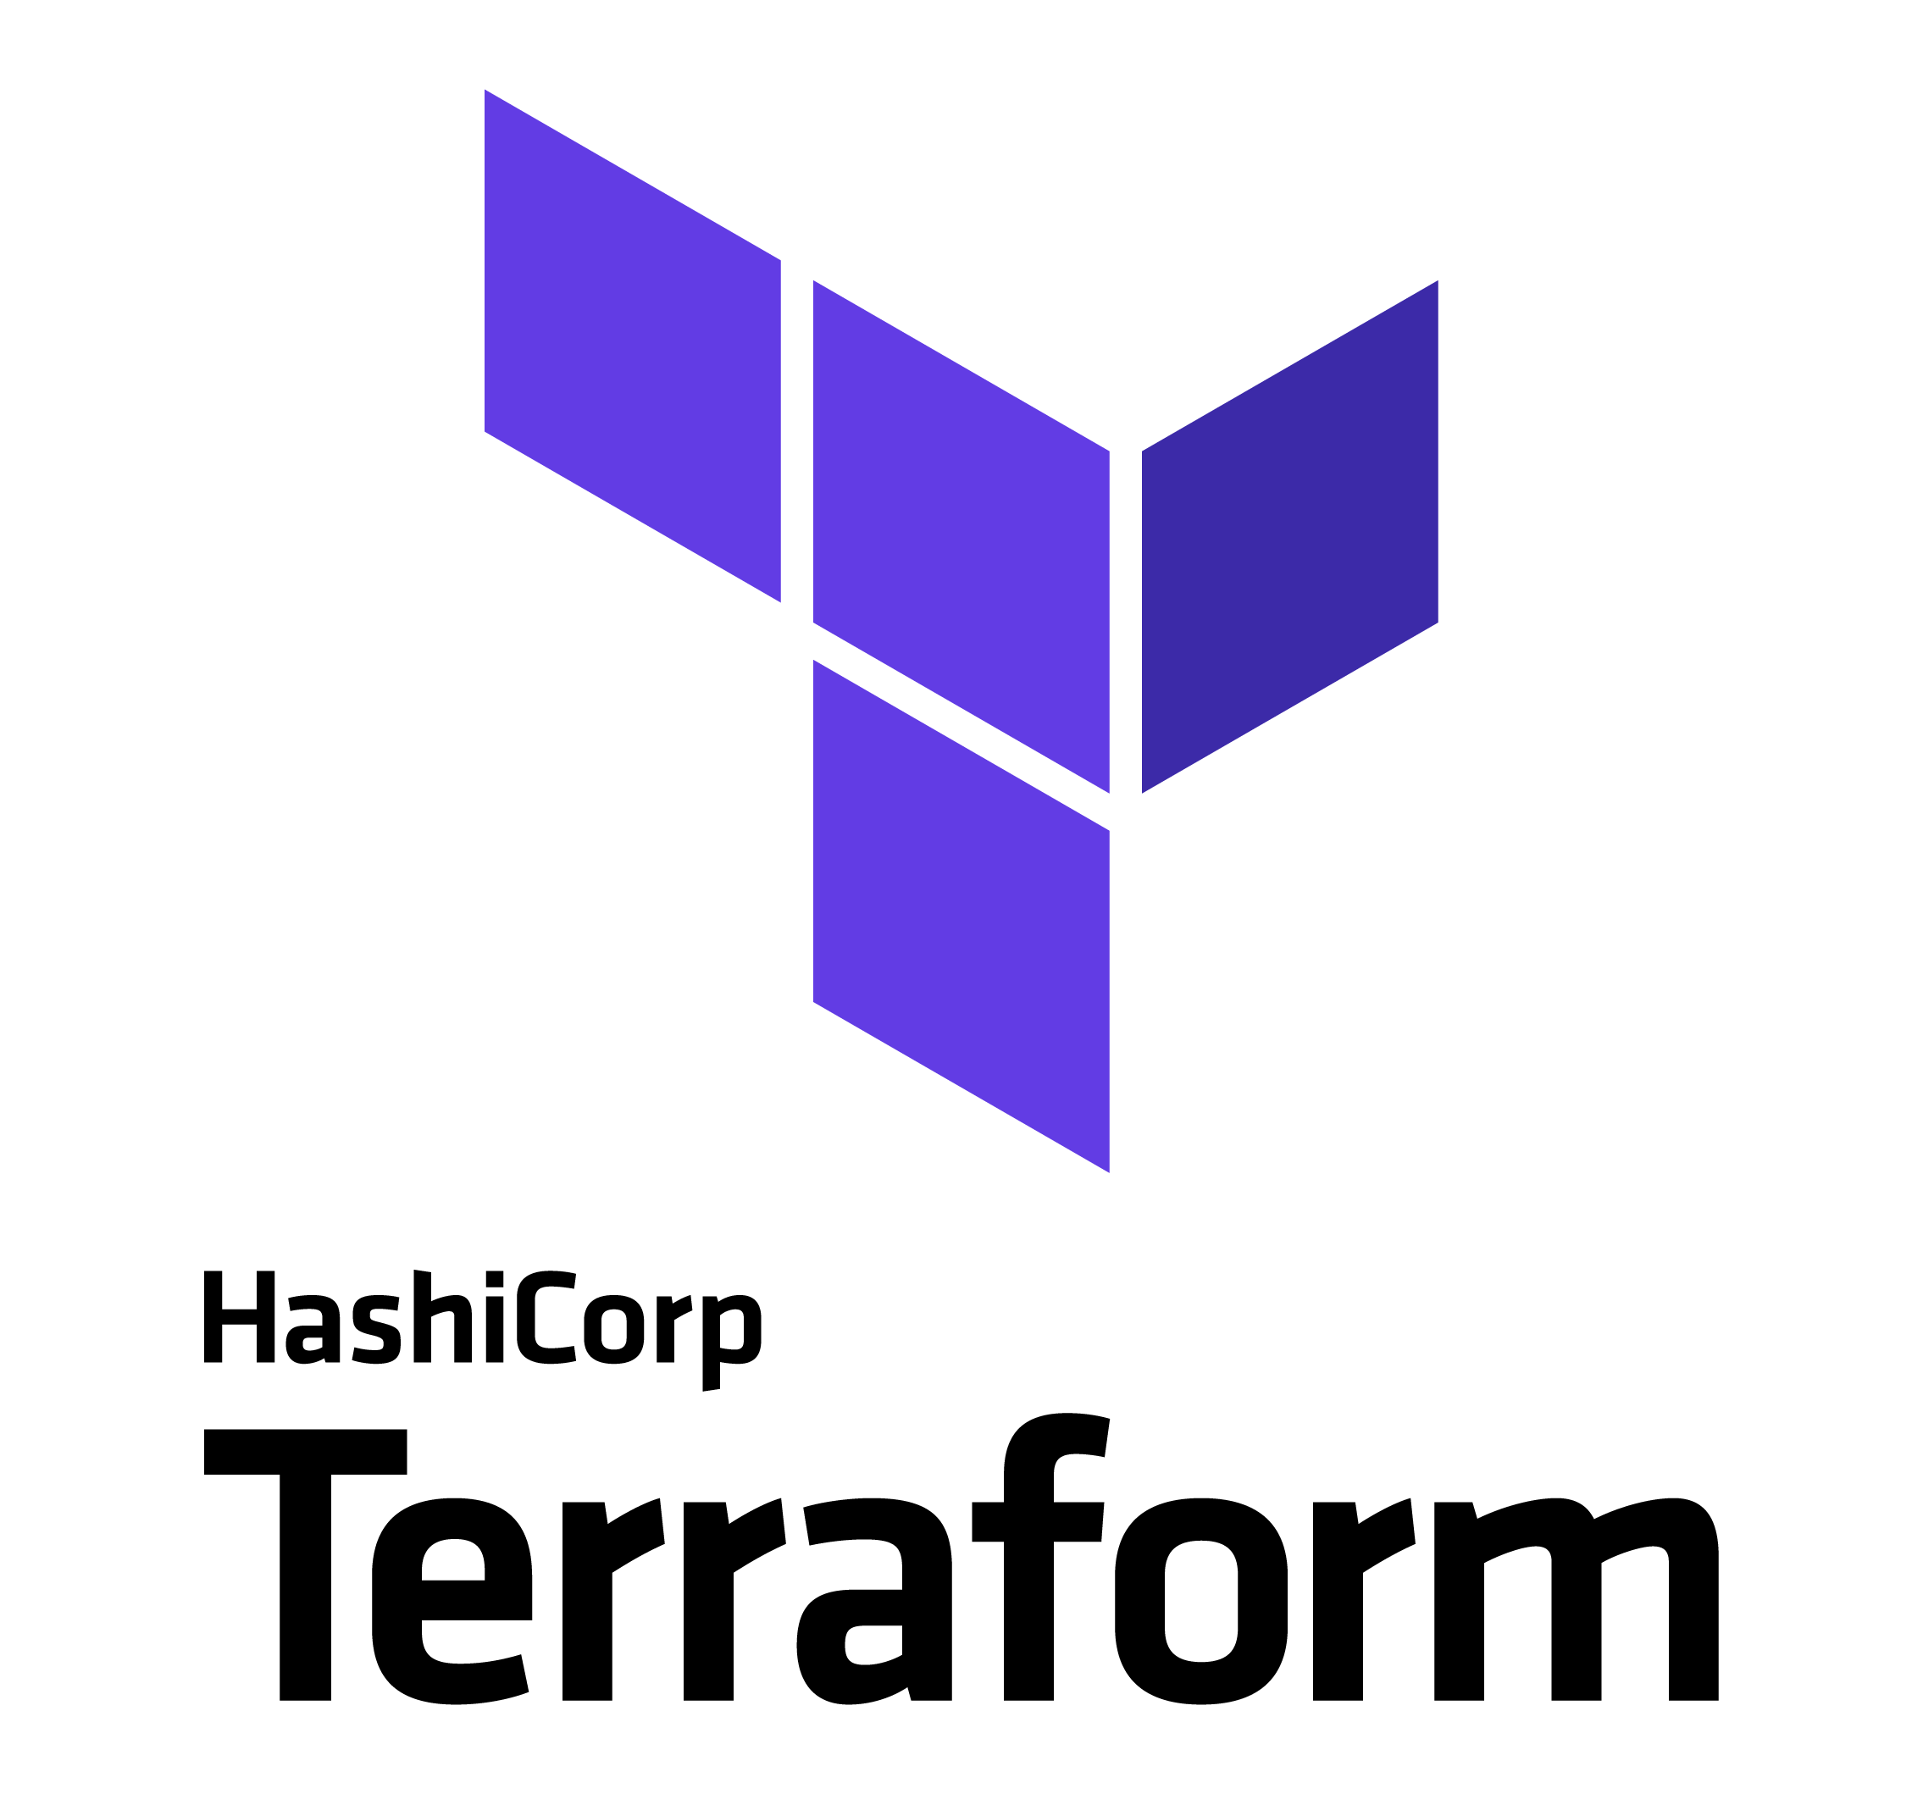
Terraform Quick Facts
Command-line binary
Interprets declarative infrastructure definition files written in HashiCorp Configuration Language or HCL
3 forms of TF you will probably encounter: OSS, TFC, and TFE
Support for 3rd party infrastructure (including AzureRM, GCP, and AWS) through “providers” mechanism
Notes:
[DEMO]

Slide 9
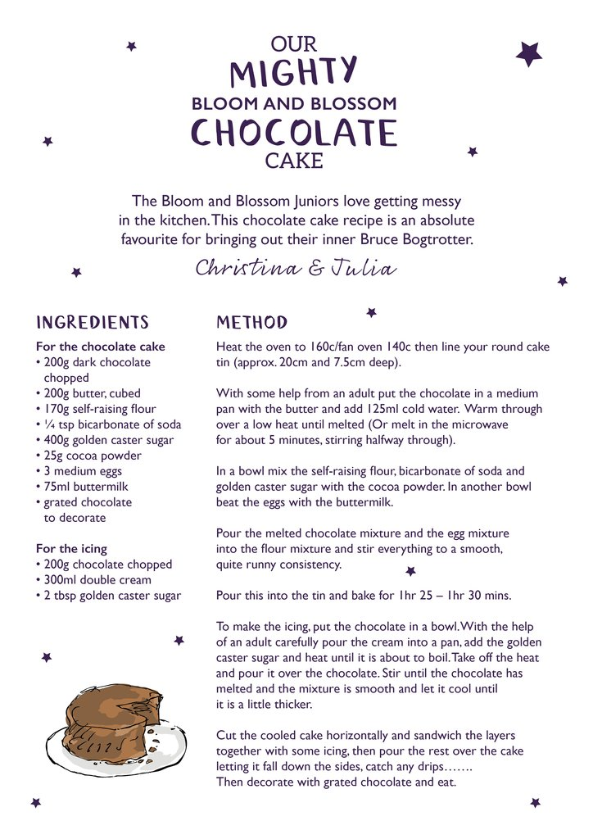

Imperative vs Declarative
Notes:
A crude but effective example of how HashiCorp Terraform’s core principle of declarative infrastructure is by comparing the recipe for a cake and saying “I want some cake”.
Imperative
More concerned with a series of steps to achieve end goal (How); How does Azure deploy resources
Declarative
Is only concerned with the end goal (steps are unimportant) (What) ; What do you want to deploy?
The imperative approach is concerned with HOW you're actually going to get a seat. You need to list out the steps to be able to show HOW you're going to get a table. The declarative approach is more concerned with WHAT you want, a table for two.
Terraform isn’t concerned with how the process of getting you want you want – it just cares what you want and gives it to you.
It doesn’t care about the specific flavor or styel, it just needs to know what you want

Slide 10
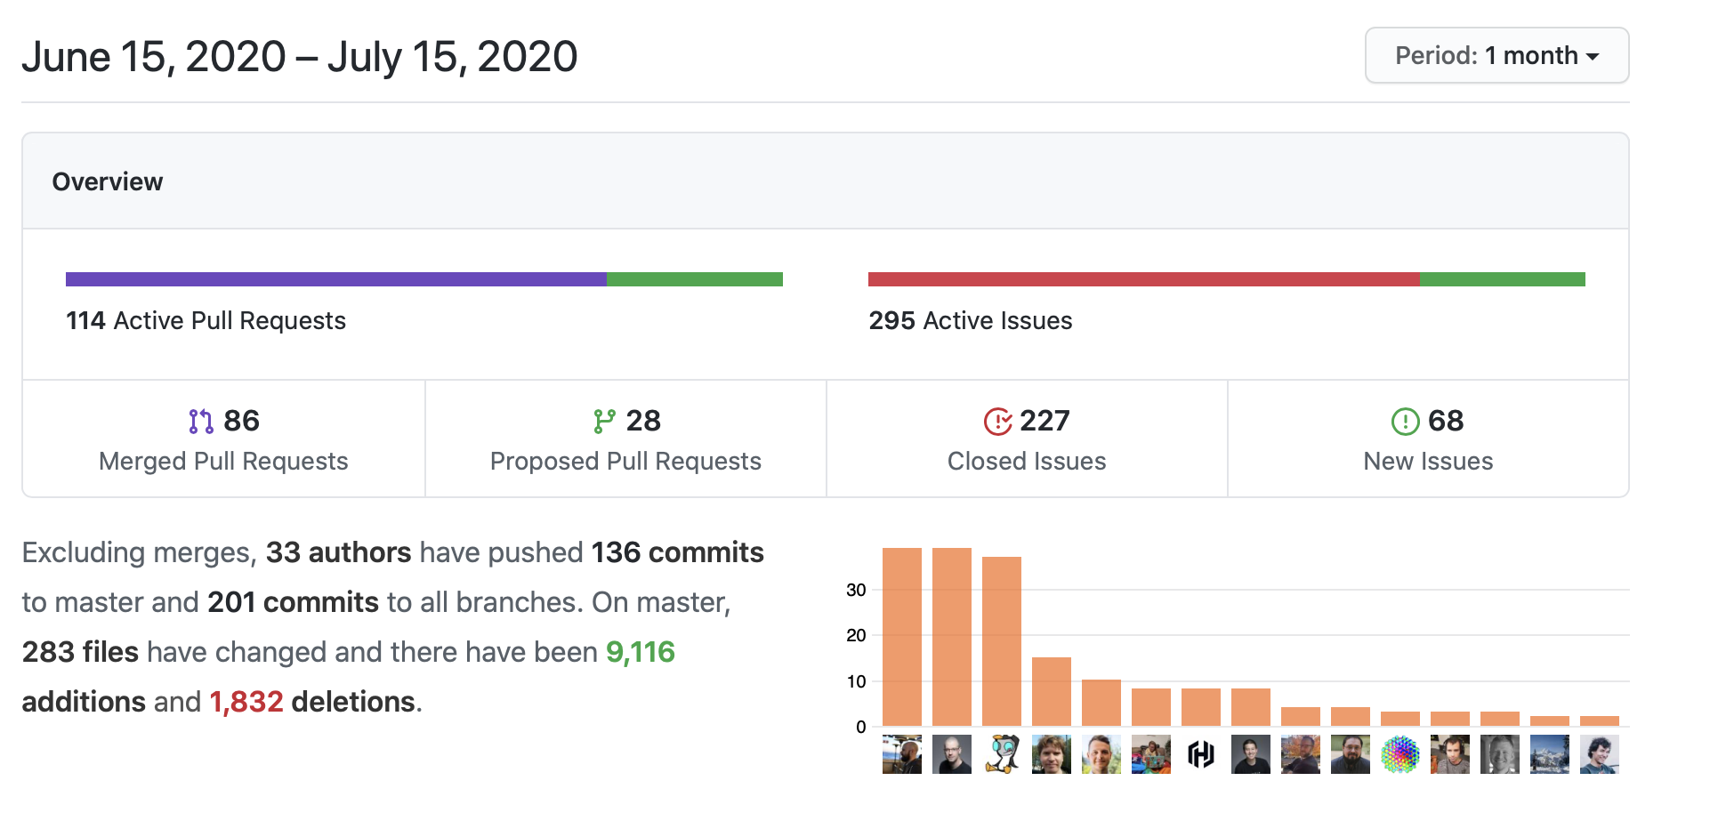
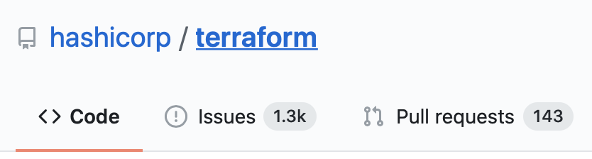
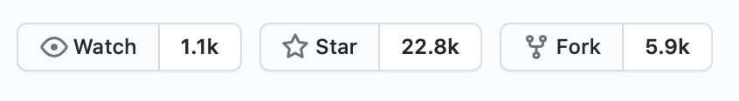
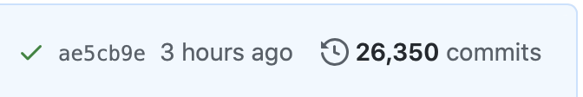
Terraform OSS community
is quite active
Notes:
Terraform Open Source community is very active. Contributors are constantly updating and improving Terraform and the platforms and services it supports.

Slide 11
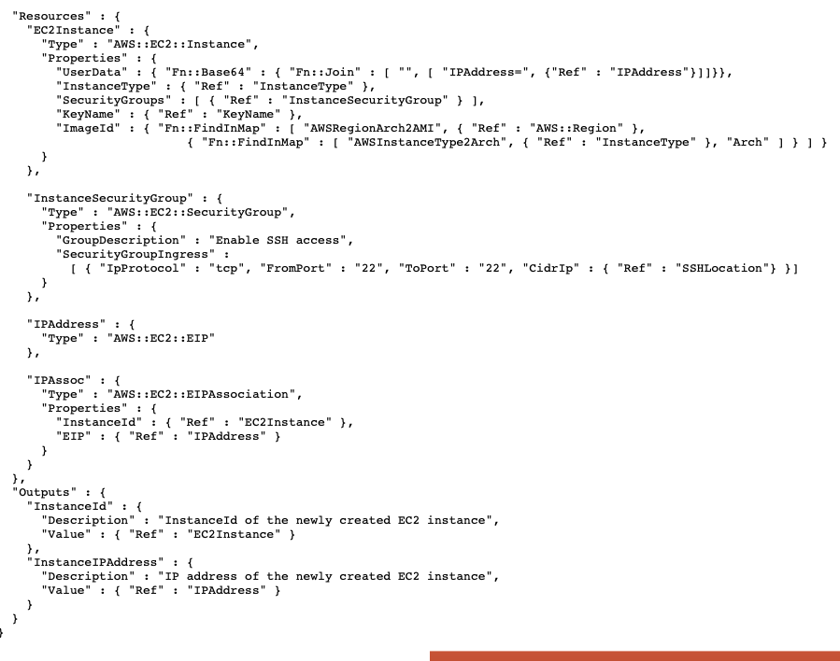
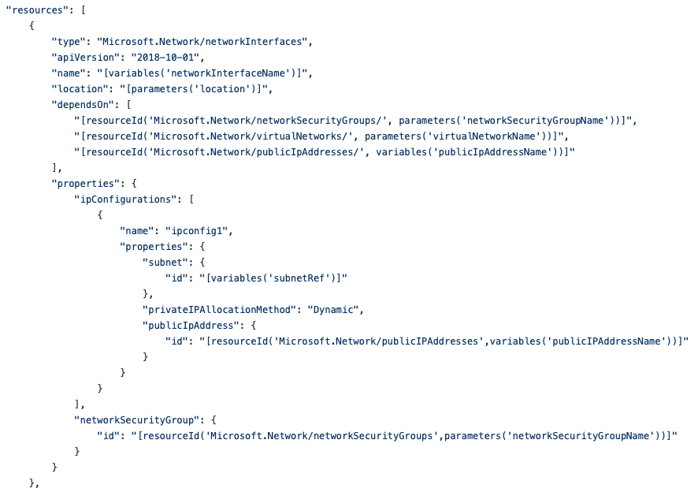
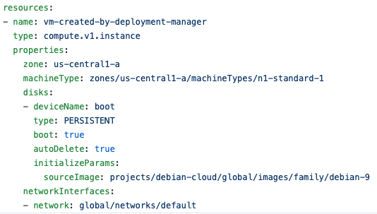



Why *Not* Use Cloud-Native Templates?
Notes:
Why not use Cloud-Native templates – or even some other languages?
Cloud-native are complex, siloed, only effective in one environment
Maintaining multiple languages and syntaxes requires a massive amount of effort, introduces complexity between platforms, and generally slows down development and decreases value.
(maybe)
You can create and manage Azure resources with ARM and BICEP – two Azure-specific languages – as well as Powershell and CLI/Bash. But even just maintaining infrastructure between those requires understanding how your infrastructure has been deployed.

Slide 12
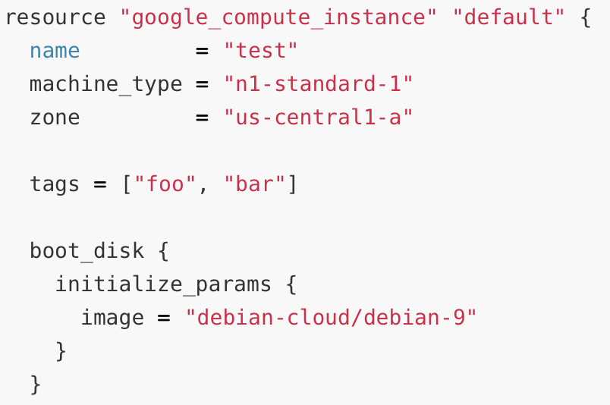
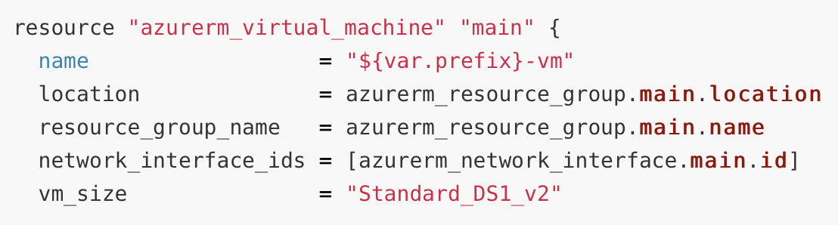
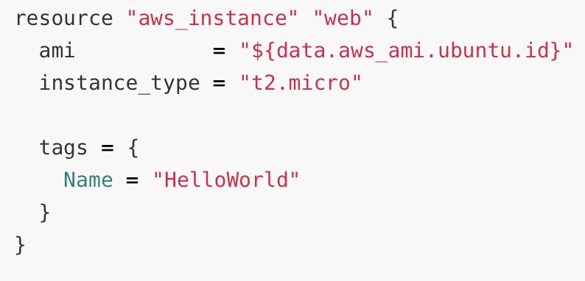
HashiCorp Config Language
a common syntax to express the modern datacenter

Slide 13
HashiCorp Configuration Language
“HCL”

Slide 14
HCL
Used for all Terraform configuration regardless of cloud
Declarative
Used in other HashiCorp products (not limited to Terraform!)
Independently versioned outside of Terraform

Slide 15
Blocks
resource “azurerm_resource_group” “my_first_group” {
name = “MyFirstResourceGroup”
location = “eastus2”
}
The Identifiers of a Block:
type
resource type
local name
attributes or arguments
block delimeter

Slide 16
Common Terraform Types
resource – declares resources
variable – defines variable input to Terraform
output – defines output from Terraform
data – retrieves data from API
terraform – defines Terraform configuration options
provider – declare and configure provider

Slide 17



Terraform Providers
pluggable 3rd party APIs with a common syntax (HCL)

Slide 18
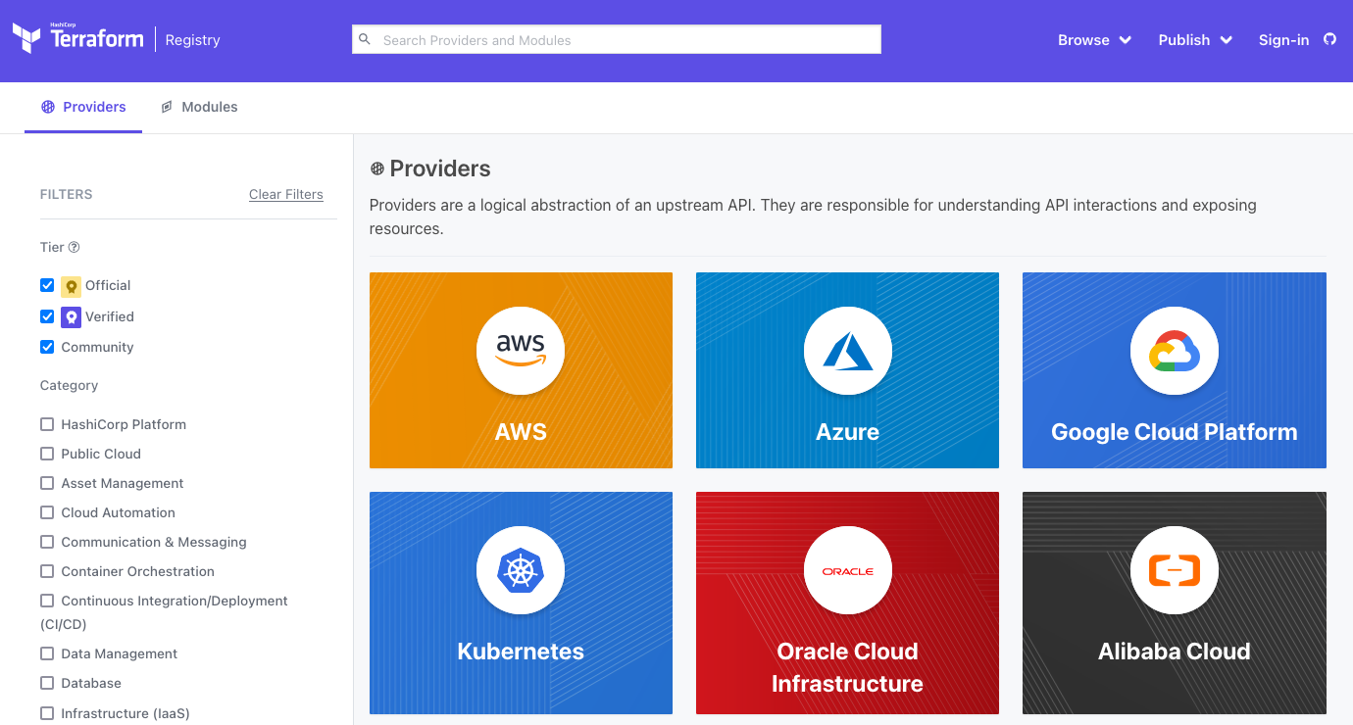
Using Providers
https://registry.terraform.io

Slide 19
Lab Time! Create a Provider File
Labs are located in a Repo at: https://github.com/devops-workshops-bhs/devops-workshop/blob/main/Day1/Day1_Labs.md
We encourage collaboration during the labs – if you run into an issue or error, please be prepared to share your screen so we can all collaborate (and learn)!

Slide 20

Getting Started with Azure Provider
Lab Time: 30 minutes

Slide 21
Terraform Workflow
post-lab review

Slide 22
Terraform Workflow
`terraform init` is used to download provider version(s) and remote modules (Day2!)
Creates the `.terraform` directory
You don’t have to run `init` every time, only when you change provider or module versions, or you need to recreate the `.terraform` directory
`terraform plan` to see the anticipated changes without actually making changes
`terraform apply` to apply your IaC
`terraform destroy` to destroy everything! 🔥DANGER💀DANGER🔥

Slide 23
Terraform Command Line
Terraform has subcommands that perform different actions.
Terraform is an open source provisioning tool.
It ships as a single binary which is written in Go. Terraform is cross platform and can run on Linux, Windows, or MacOS.
Installing terraform is easy. You simply download a zip file, unzip it, and run it.
# Basic Terraform Commands
terraform version
terraform help
terraform init
terraform plan
terraform apply
terraform destroy

Slide 24
Terraform Help
$ terraform help
Usage: terraform [-version] [-help] <command> [args]
...
Common commands:
apply Builds or changes infrastructure
console Interactive console for Terraform interpolations
destroy Destroy Terraform-managed infrastructure
env Workspace management
fmt Rewrites config files to canonical format
graph Create a visual graph of Terraform resources
Type terraform subcommand help to view help on a particular subcommand.
Notes:
Use `terraform help` to learn about the different, common commands
You can find help on specific subcommand with terraform <subcommand> help

Slide 25
Terraform Configuration
and Versioning

Slide 26
Terraform Configuration
terraform {
required_version = “~> 1.1.0”
}
Version Constraint Operators
“~>” is the pessimistic constraint operator
>=, <=, >, <, =
“!=“ excludes exact version
Can chain constraints with commas “,”
Notes:
~>: Allows only the rightmost version component to increment. For example, to allow new patch releases within a specific minor release, use the full version number: ~> 1.0.4 will allow installation of 1.0.5 and 1.0.10 but not 1.1.0. This is usually called the pessimistic constraint operator.

Slide 27
Terraform and Provider Versions

Slide 28
Terraform and Provider Versions
post-lab review

Slide 29

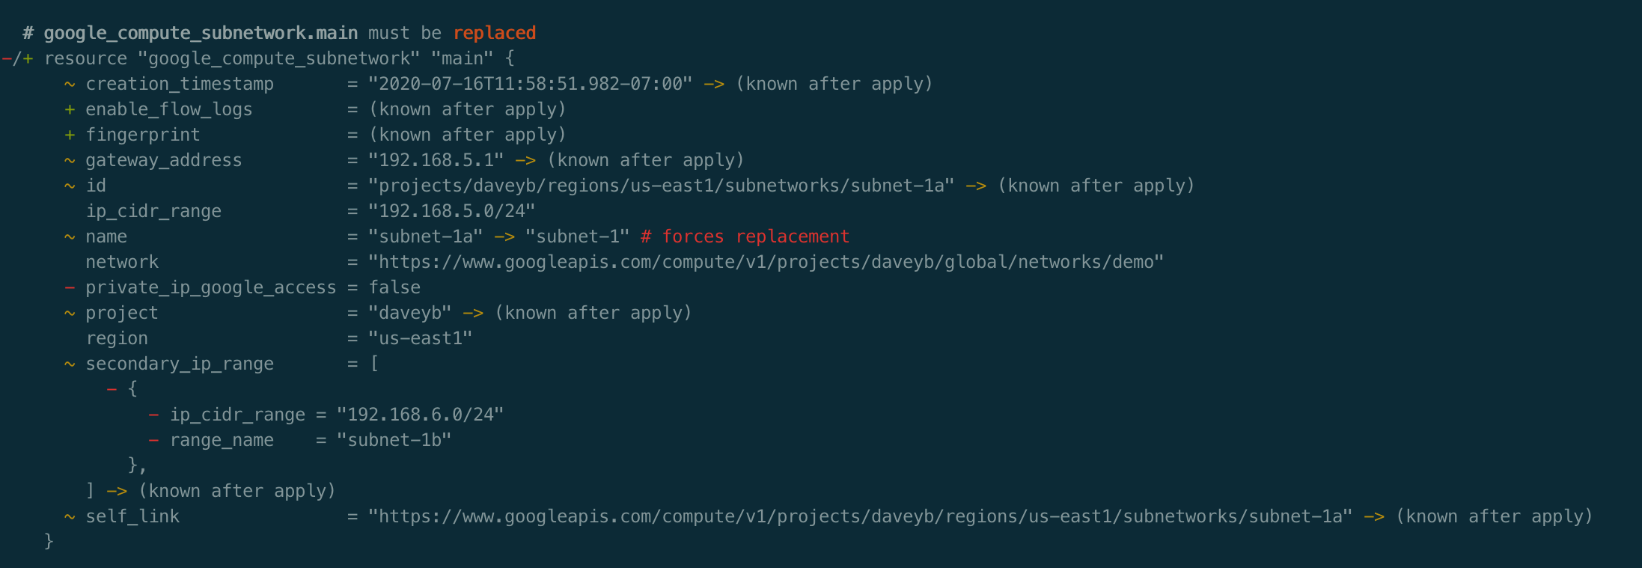

State
plan for day 2 changes
terraform plan
main.tf resource ”some_resource” “main” {
…
}
some_resource
terraform apply
terraform.tfstate
{
"version": 4,
"terraform_version”: ,
"outputs": {},
"resources": [ “some_resource” ] … }

Slide 30
Terraform Operations
Configuration | State | Reality | Operation
some_resource |  |  | CREATE
some_resource | some_resource |  | CREATE
some_resource | some_resource | some_resource | NOOP
 | some_resource | some_resource | DELETE
 |  | some_resource | NOOP
some_resource |  | some_resource | RECREATE (API Error)
 | some_resource |  | REMOVE FROM STATE
Notes:
Here you’ll see “Configuration”, “State”, “Reality”, and “Operation”. This table shows the OPERATION that will occur depending
Some clarification on what RECREATE means as there was much discussion about it.
If the resource is not in state, but exists in reality and exists in the configuration, Terraform will attempt to create the resource (again) on Apply. The API will return an error that the resource cannot be created due to a name conflict and Terraform will raise a message suggesting the resource be imported into state so that it can manage it.

Slide 31
Terraform Variables
plan for differences amongst deployments

Slide 32
Variables
variable “some_variable_name_i_choose” {
description = “Optional variable description.”
type = optional variable type
default = optional (but sensible) default value
}
Passing Variable Values into Terraform
“-var” flag
“.tfvars” file
“TF_VAR_” shell environment variable value

Slide 33
Variables

Slide 34
Terraform Variables
post-lab review

Slide 35
Plan Output Binary
Demo

Slide 36
Plan Output Binary
post-lab review

Slide 37
Questions
What happens when you try to apply a “stale” plan that was output with “-out”?
How does the “-out” parameter simplify variable inputs?
How could plan outputs be useful?

Slide 38
A “Real” Deployment

Slide 39
A “Real” Deployment
post-lab review

Slide 40
GitHub Overview
Are you one of the 65+ million GitHub users?

Slide 41
What is GitHub?
“GitHub is a code hosting platform for version control and collaboration. It lets you and others work together on projects from anywhere.”
https://guides.github.com/activities/hello-world/

Slide 42
Core GitHub Features
Git repositories
CI/CD with Actions
Packages
Teams
Issues
Projects
Pull requests
Secrets
Notes:
GitHub Packages is a platform for hosting and managing packages, including containers and other dependencies. GitHub Packages combines your source code and packages in one place to provide integrated permissions management and billing, so you can centralize your software development on GitHub.
Teams are groups of organization members that reflect your company or group's structure with cascading access permissions and mentions.
A project is an adaptable spreadsheet that integrates with your issues and pull requests on GitHub to help you plan and track your work effectively.

Slide 43
GitHub Structure: Enterprise
Enterprise
Organization 1
Organization 2
Organization 3
.
.
.
Notes:
Your team can collaborate on GitHub by using an organization account, which serves as a container for your shared work and gives the work a unique name and brand.
You can invite an unlimited number of people to join your organization, then give these organization members a variety of roles that grant different levels of access to the organization and its data

Slide 44
GitHub Structure: Organization
Organization
People
Projects
Teams
Repositories
Code
CI/CD Workflows/Actions
Packages
Issues
Wiki
Pages
Notes:
You have your organization with has people, those people can be grouped into different teams and given different roles. The teams will be given access to one or more repos.
You can use projects to help manage issues and track your work.
Use CI/CD to automate the building and deploying of your code. That code can utilize packages for dependencies, and artifacts.

Slide 45

Core Features
A lightning quick tour

Slide 46
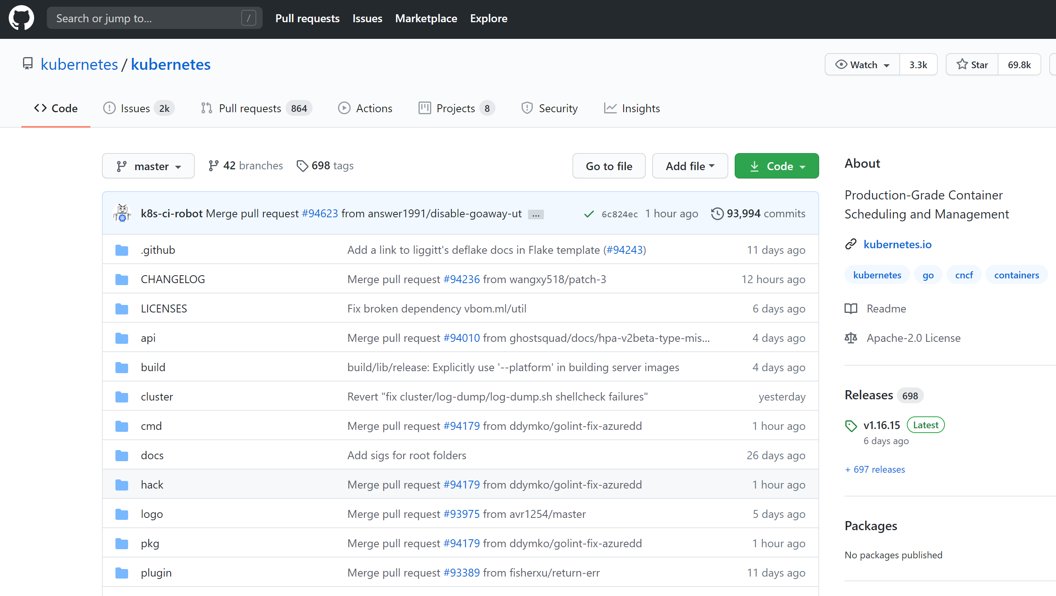
Core GitHub Features
Repos

Slide 47
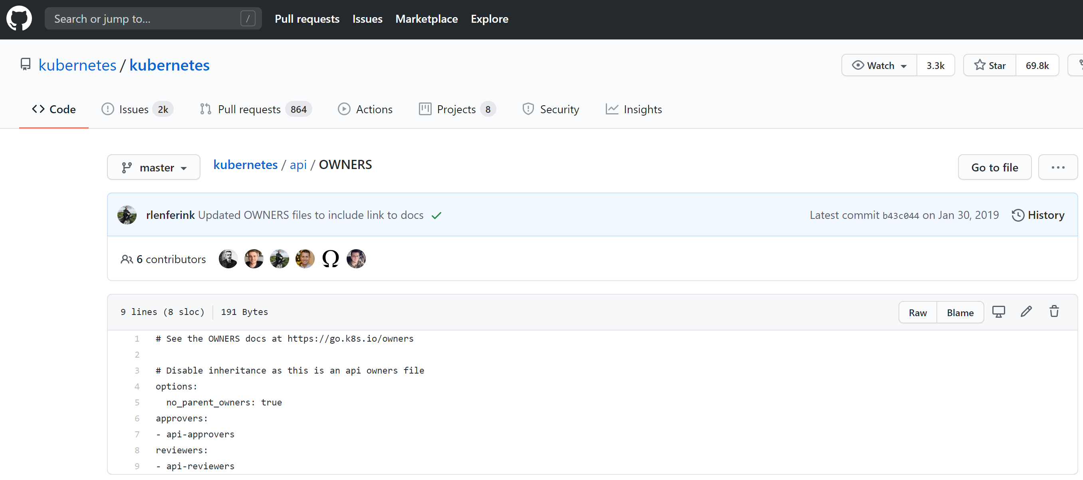
Core GitHub Features
Repos – File View

Slide 48
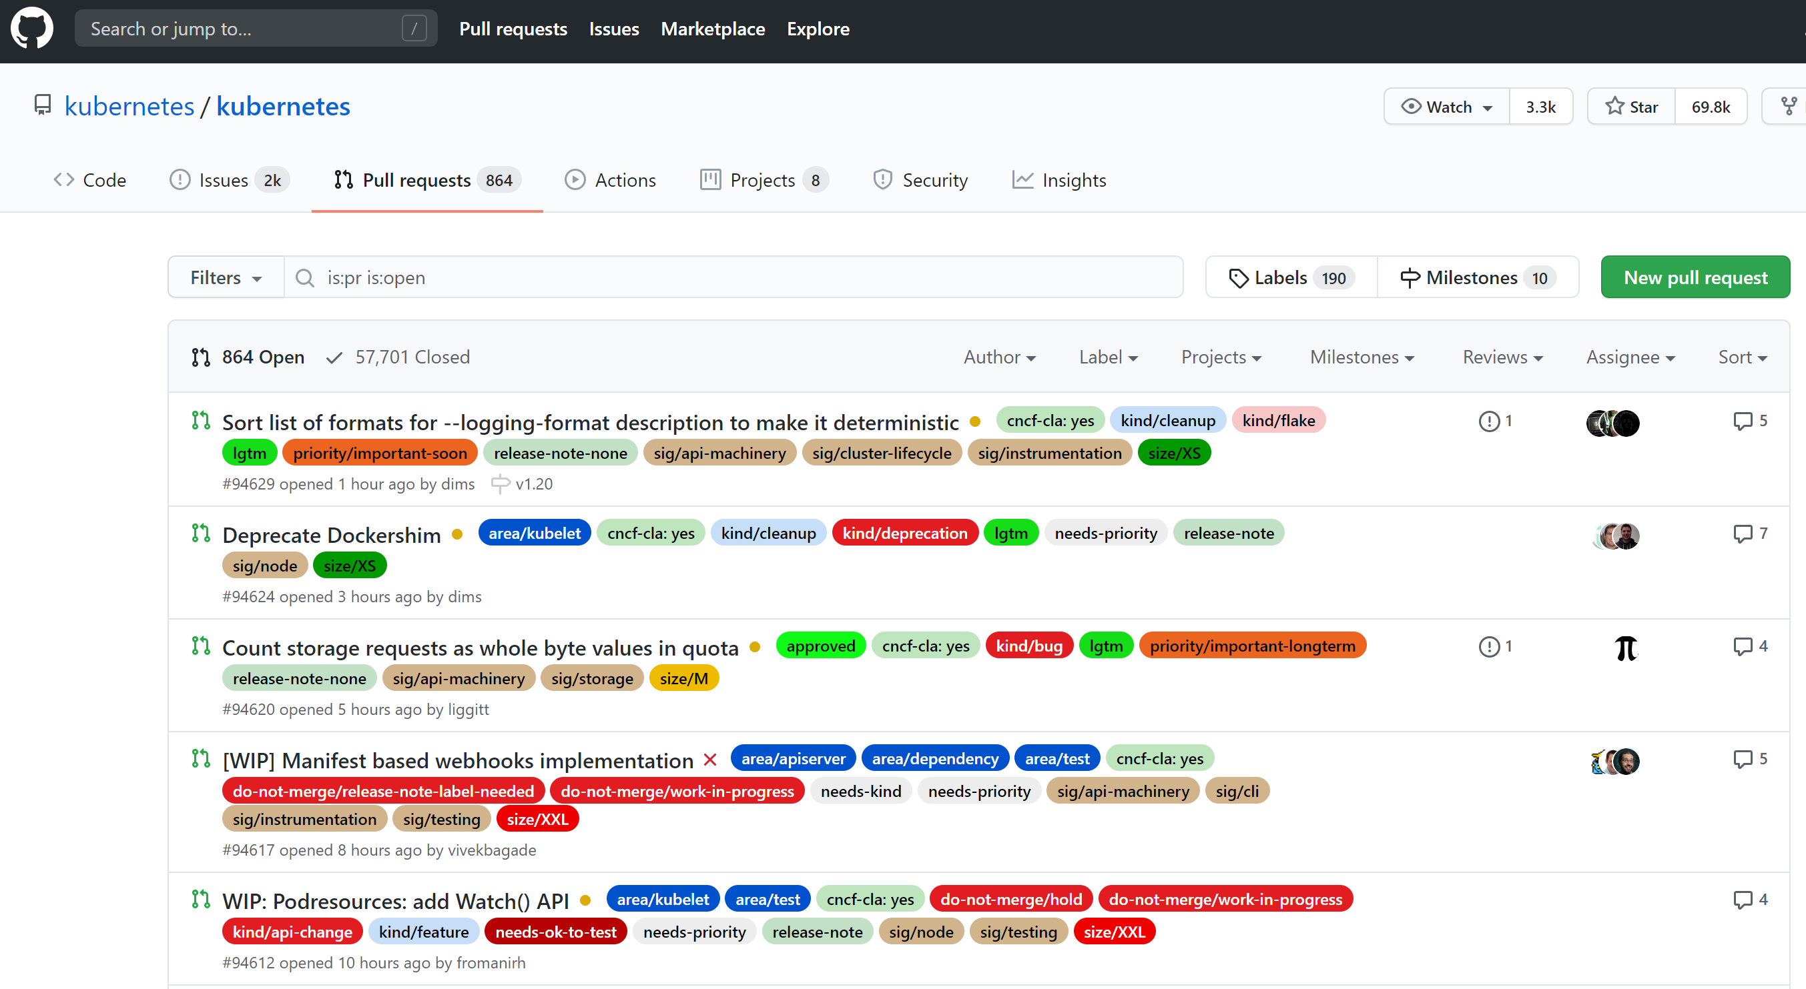
Core GitHub Features
Pull Requests

Slide 49
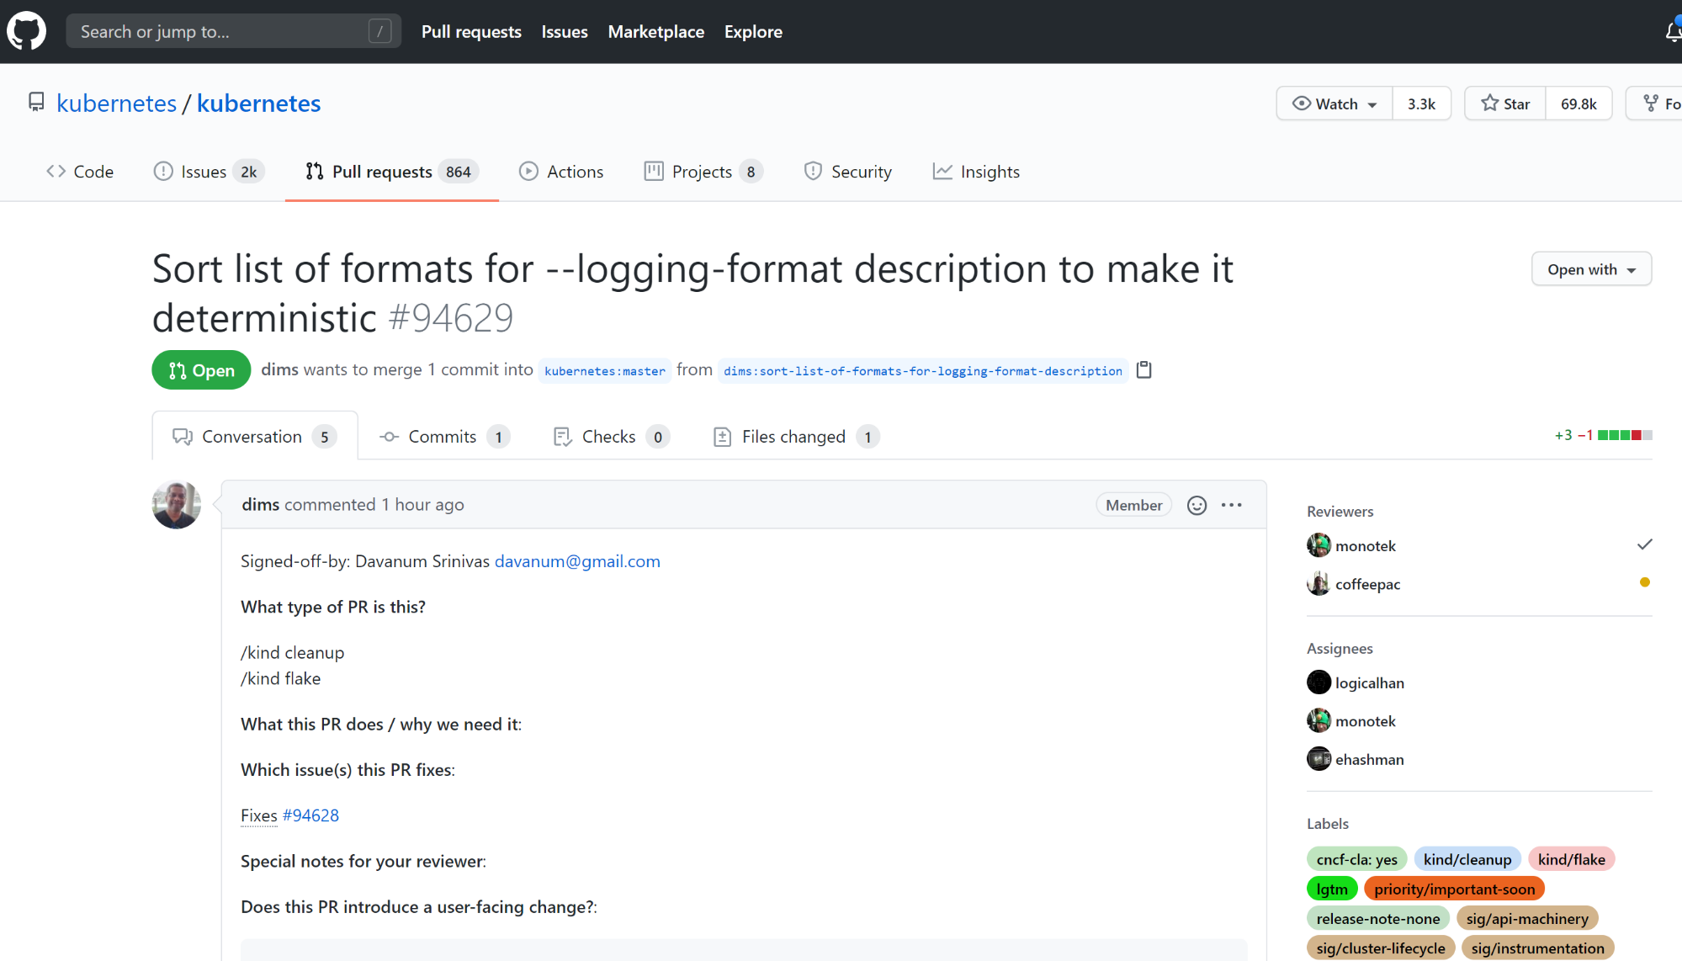
Core GitHub Features
Pull Request Details

Slide 50
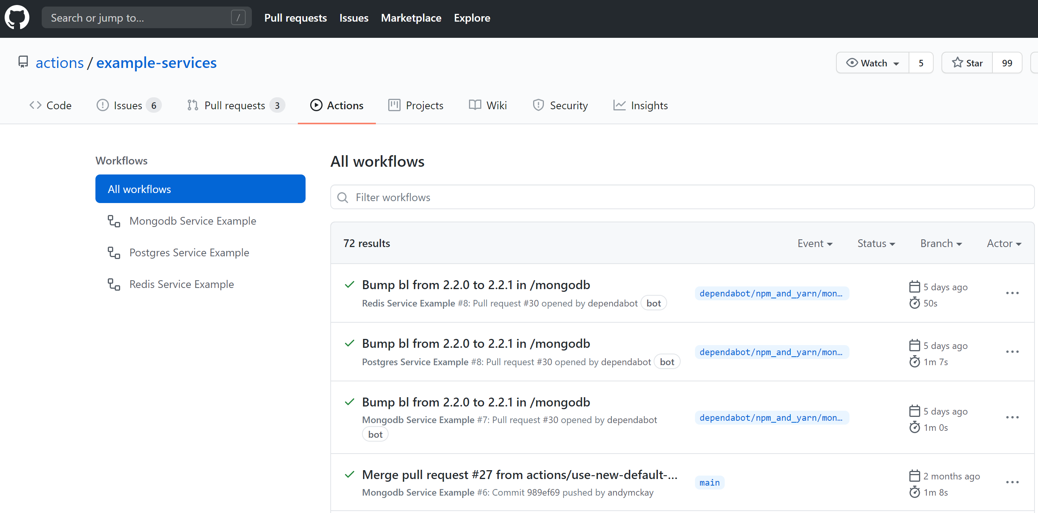
Core GitHub Features
CI/CD with Actions
Notes:
GitHub Actions is a continuous integration and continuous delivery (CI/CD) platform that allows you to automate your build, test, and deployment pipeline. You can create workflows that build and test every pull request to your repository, or deploy merged pull requests to production.

Slide 51
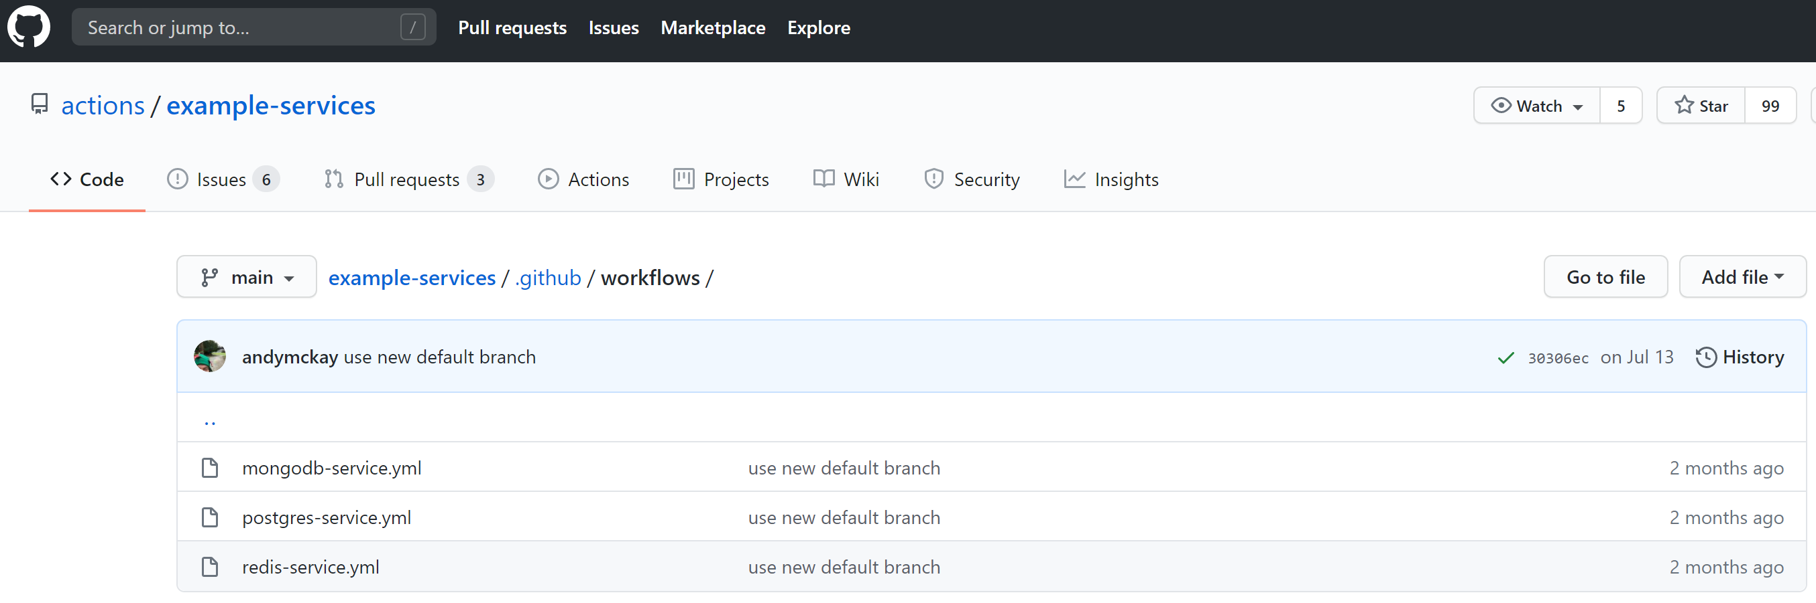
Core GitHub Features
CI/CD with Actions – Workflow files

Slide 52
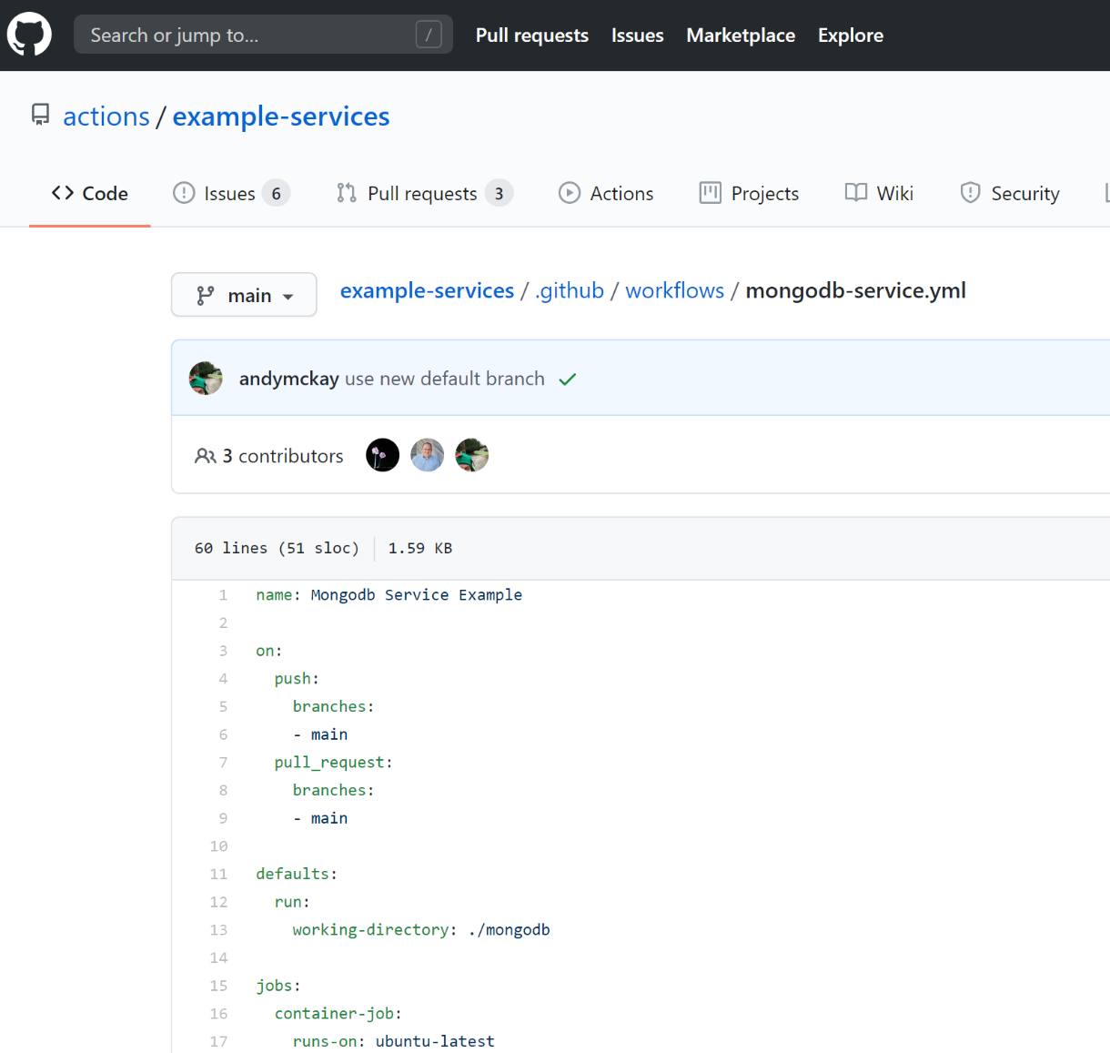
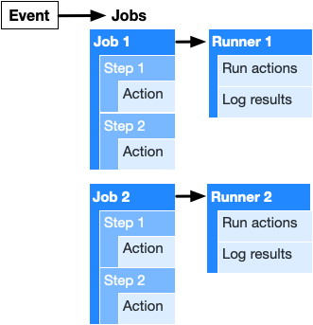
Core GitHub Features
CI/CD with Actions – YAML workflows
Notes:
You can configure a GitHub Actions workflow to be triggered when an event occurs in your repository, such as a pull request being opened or an issue being created. Your workflow contains one or more jobs which can run in sequential order or in parallel. Each job will run inside its own virtual machine runner, or inside a container, and has one or more steps that either run a script that you define or run an action, which is a reusable extension that can simplify your workflow.
A workflow is a configurable automated process that will run one or more jobs. Workflows are defined by a YAML file checked in to your repository and will run when triggered by an event in your repository, or they can be triggered manually, or at a defined schedule.

Slide 53
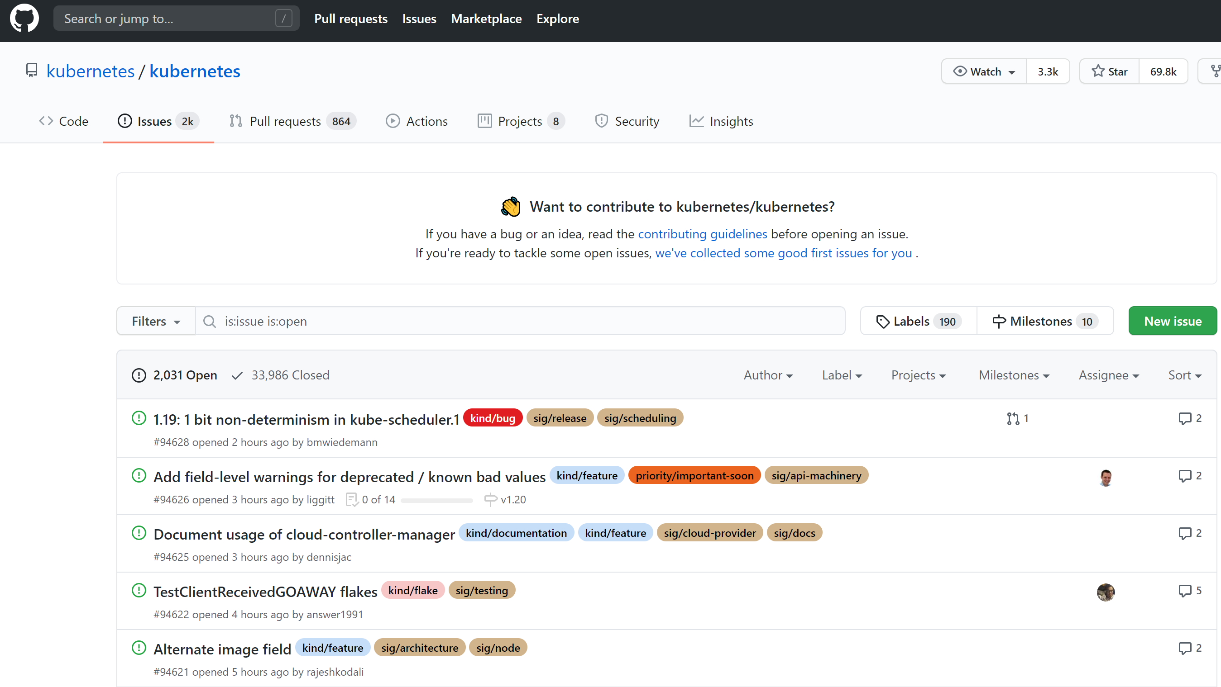
Core GitHub Features
Issues

Slide 54
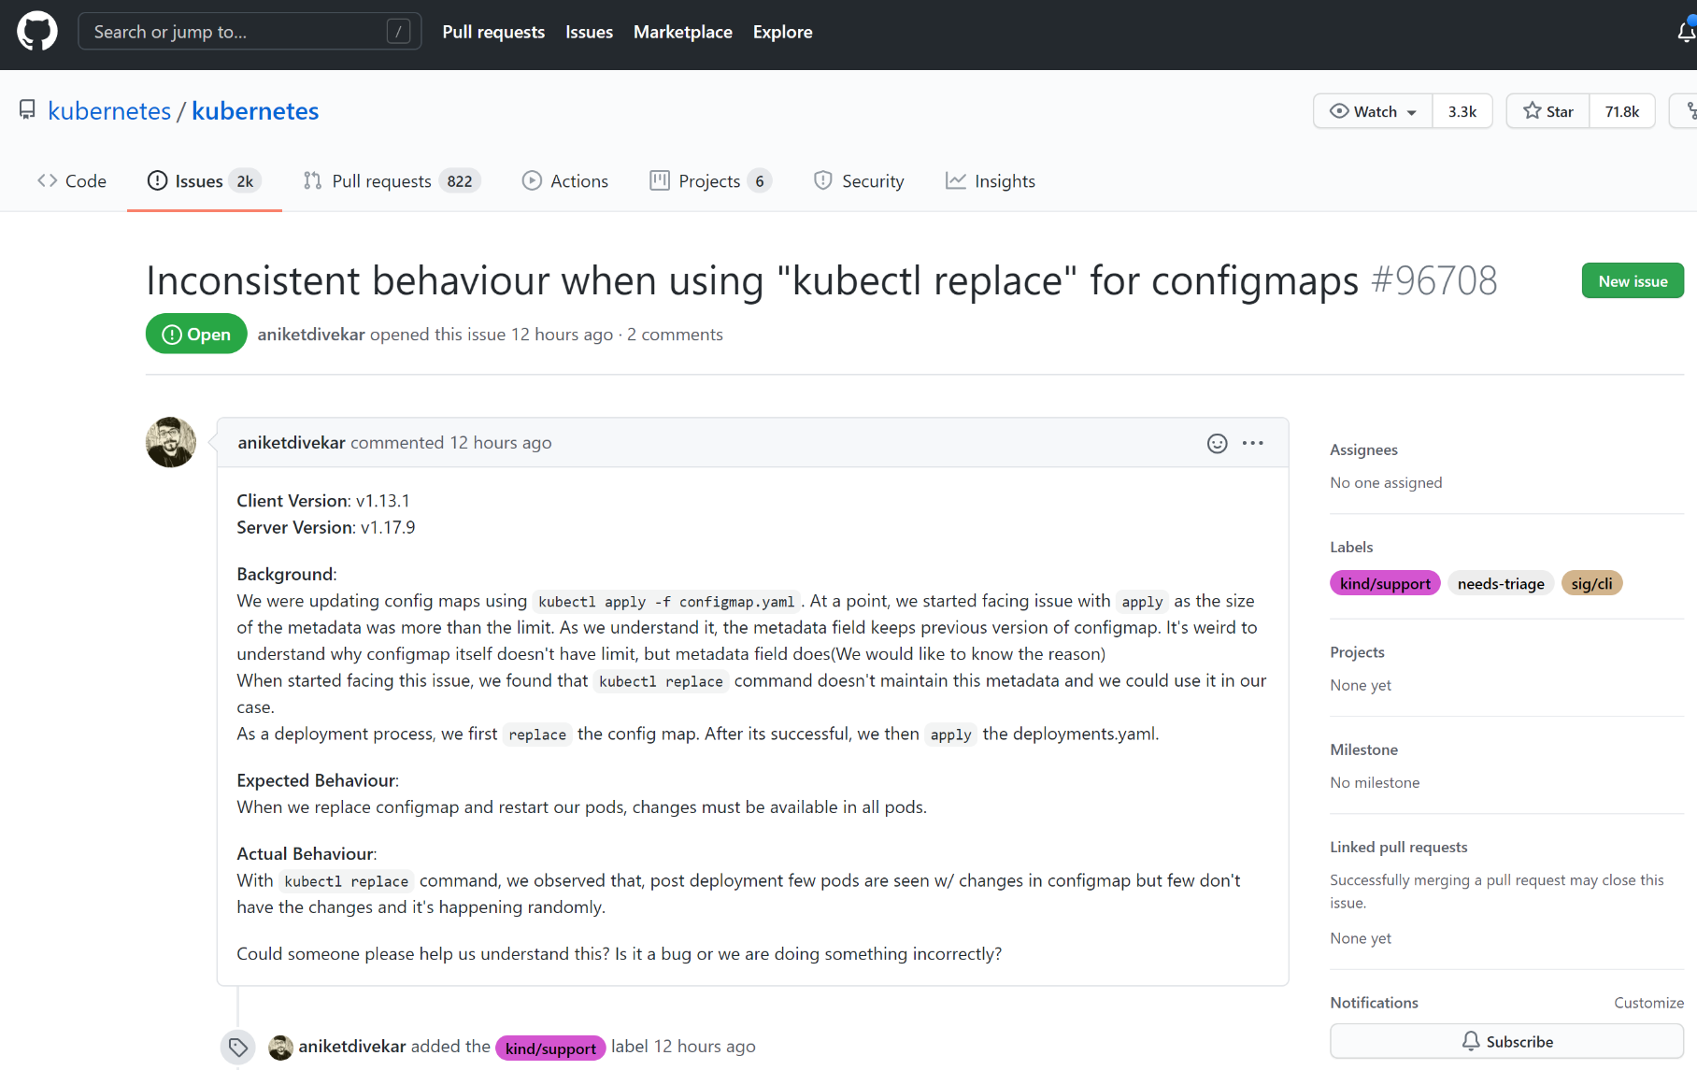
Core GitHub Features
Issues – Issue details

Slide 55
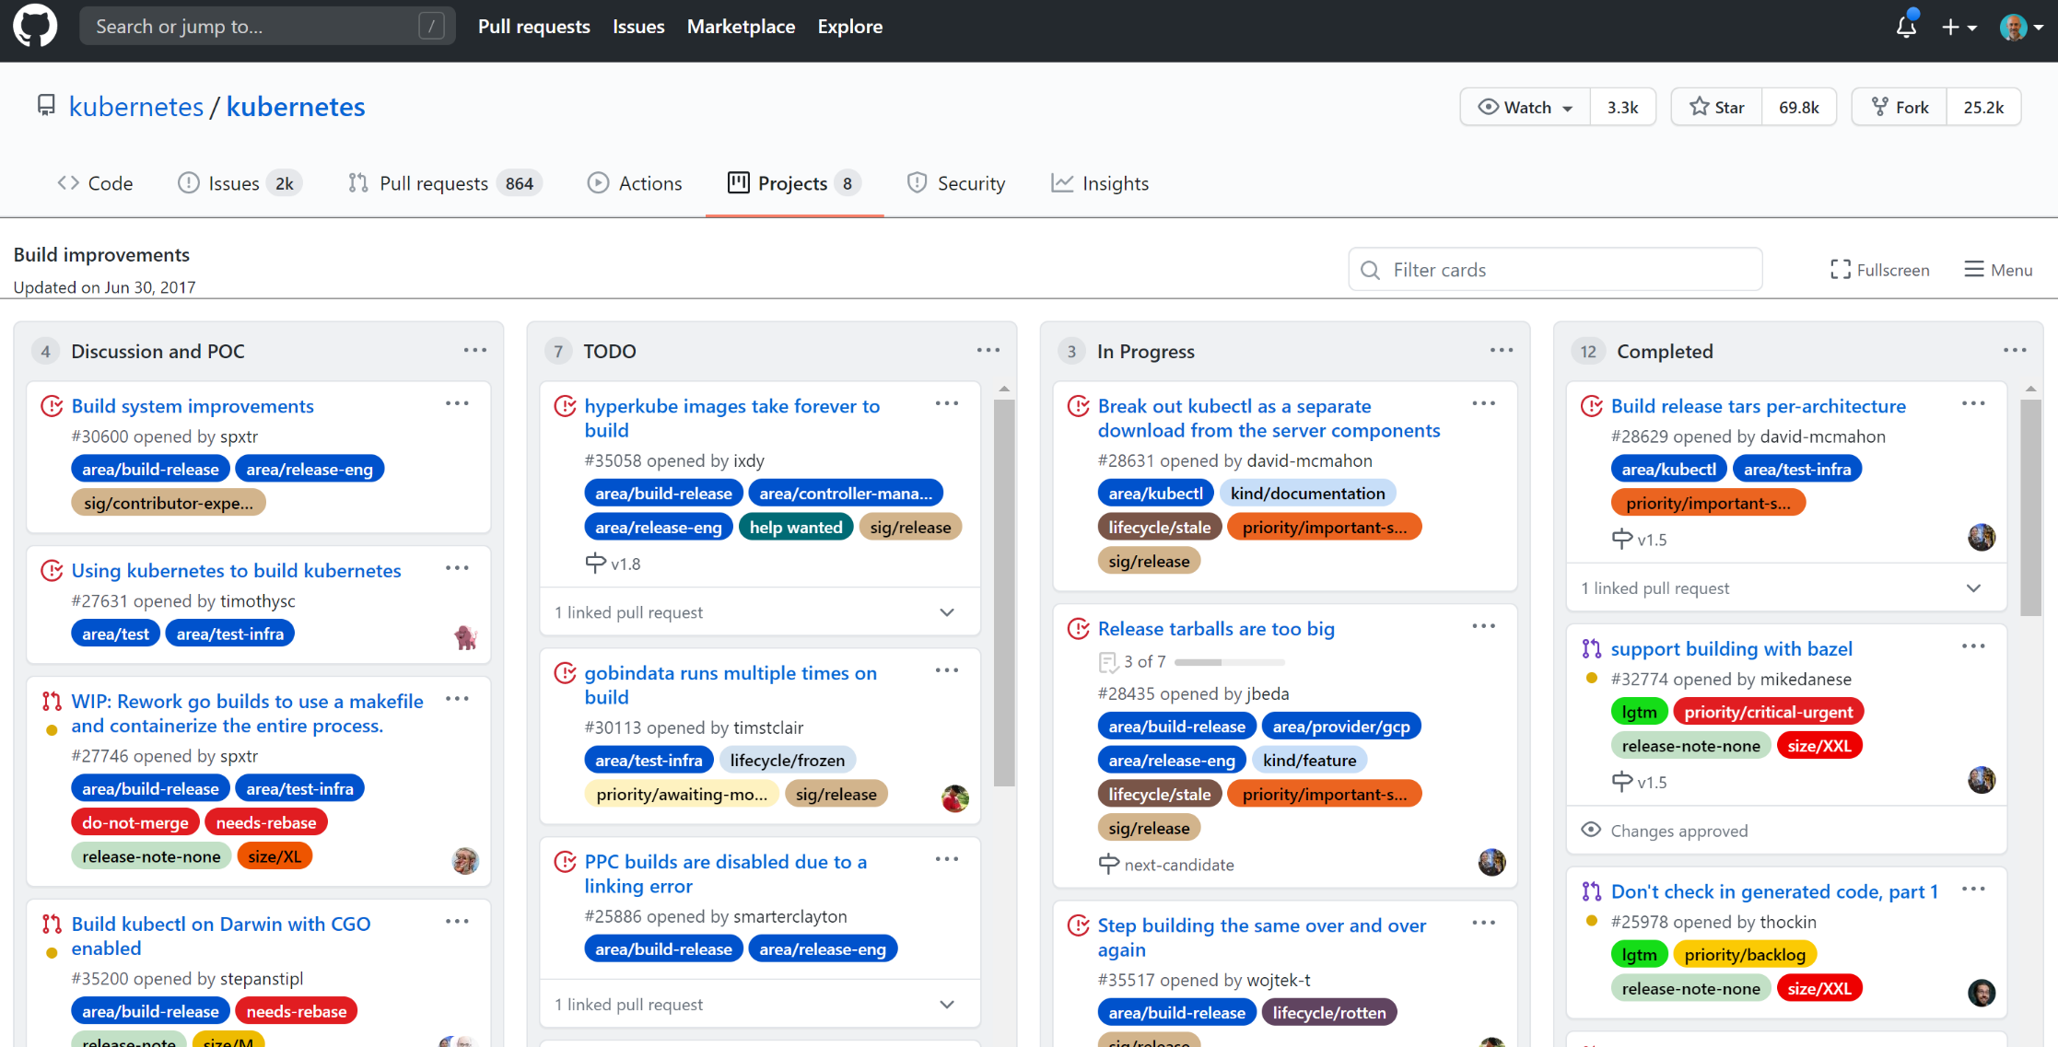
Core GitHub Features
Projects
Notes:
A project is an adaptable spreadsheet that integrates with your issues and pull requests on GitHub to help you plan and track your work effectively.
Your projects are built from the issues and pull requests you add, creating direct references between your project and your work. Information is synced automatically to your project as you make changes, updating your views and charts

Slide 56
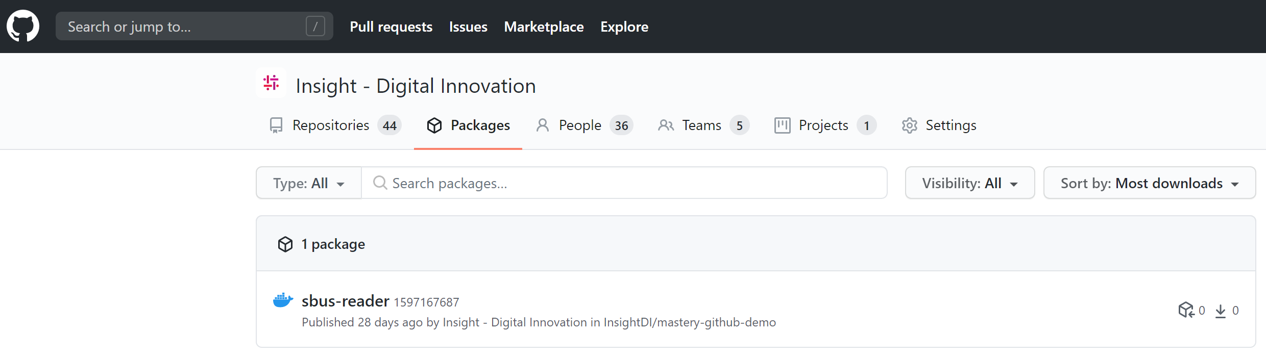
Core GitHub Features
Packages

Slide 57
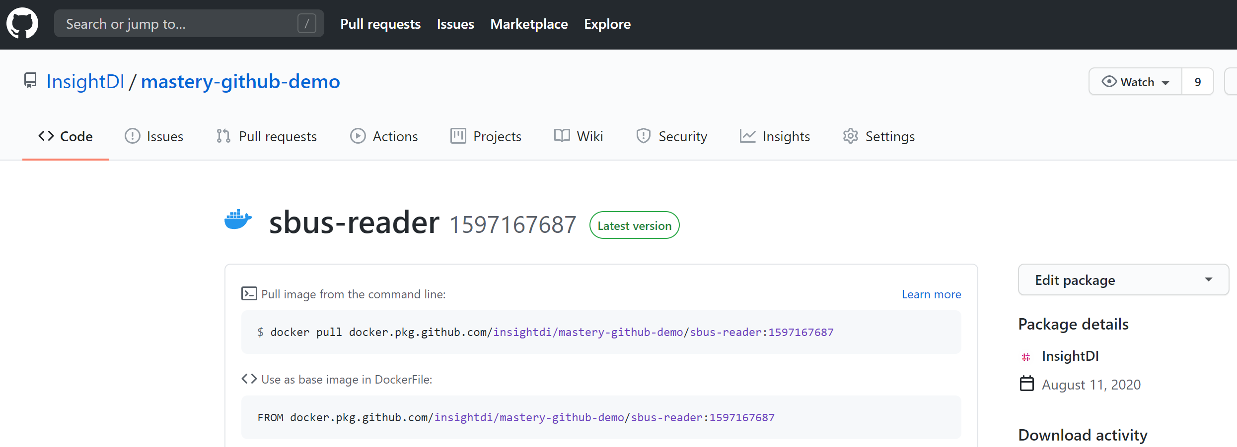
Core GitHub Features
Packages - Details

Slide 58
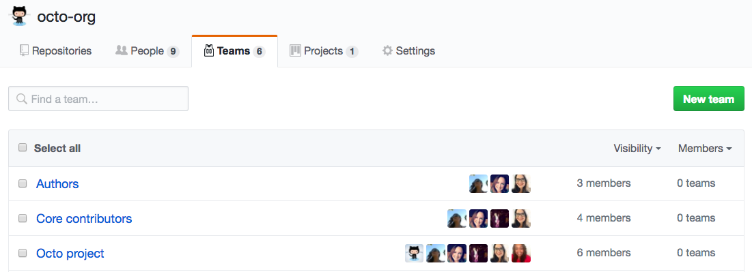
Core GitHub Features
Teams

Slide 59
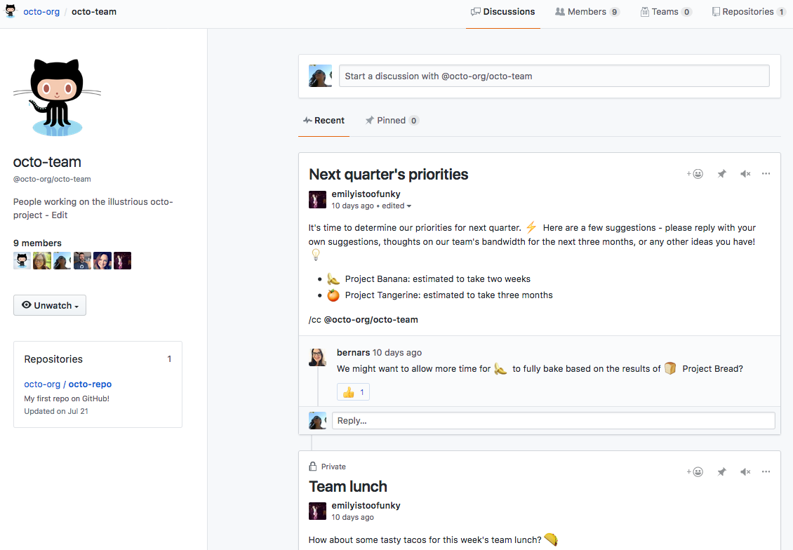
Core GitHub Features
Teams – Home page

Slide 60
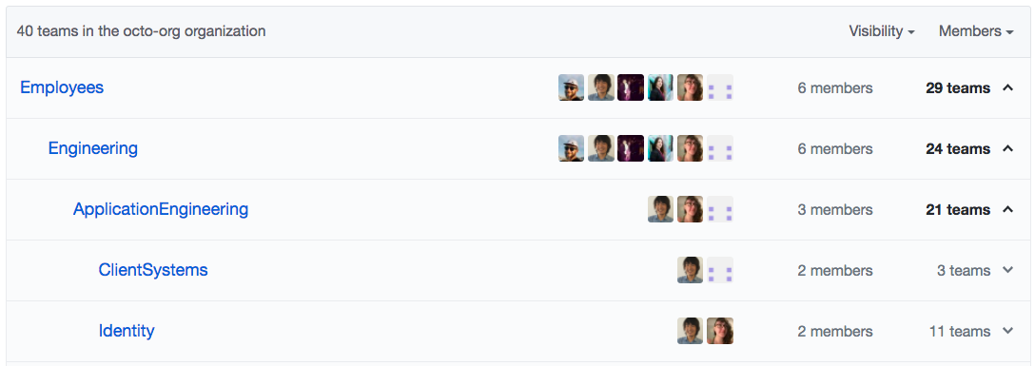
Core GitHub Features
Teams – Nested teams

Slide 61
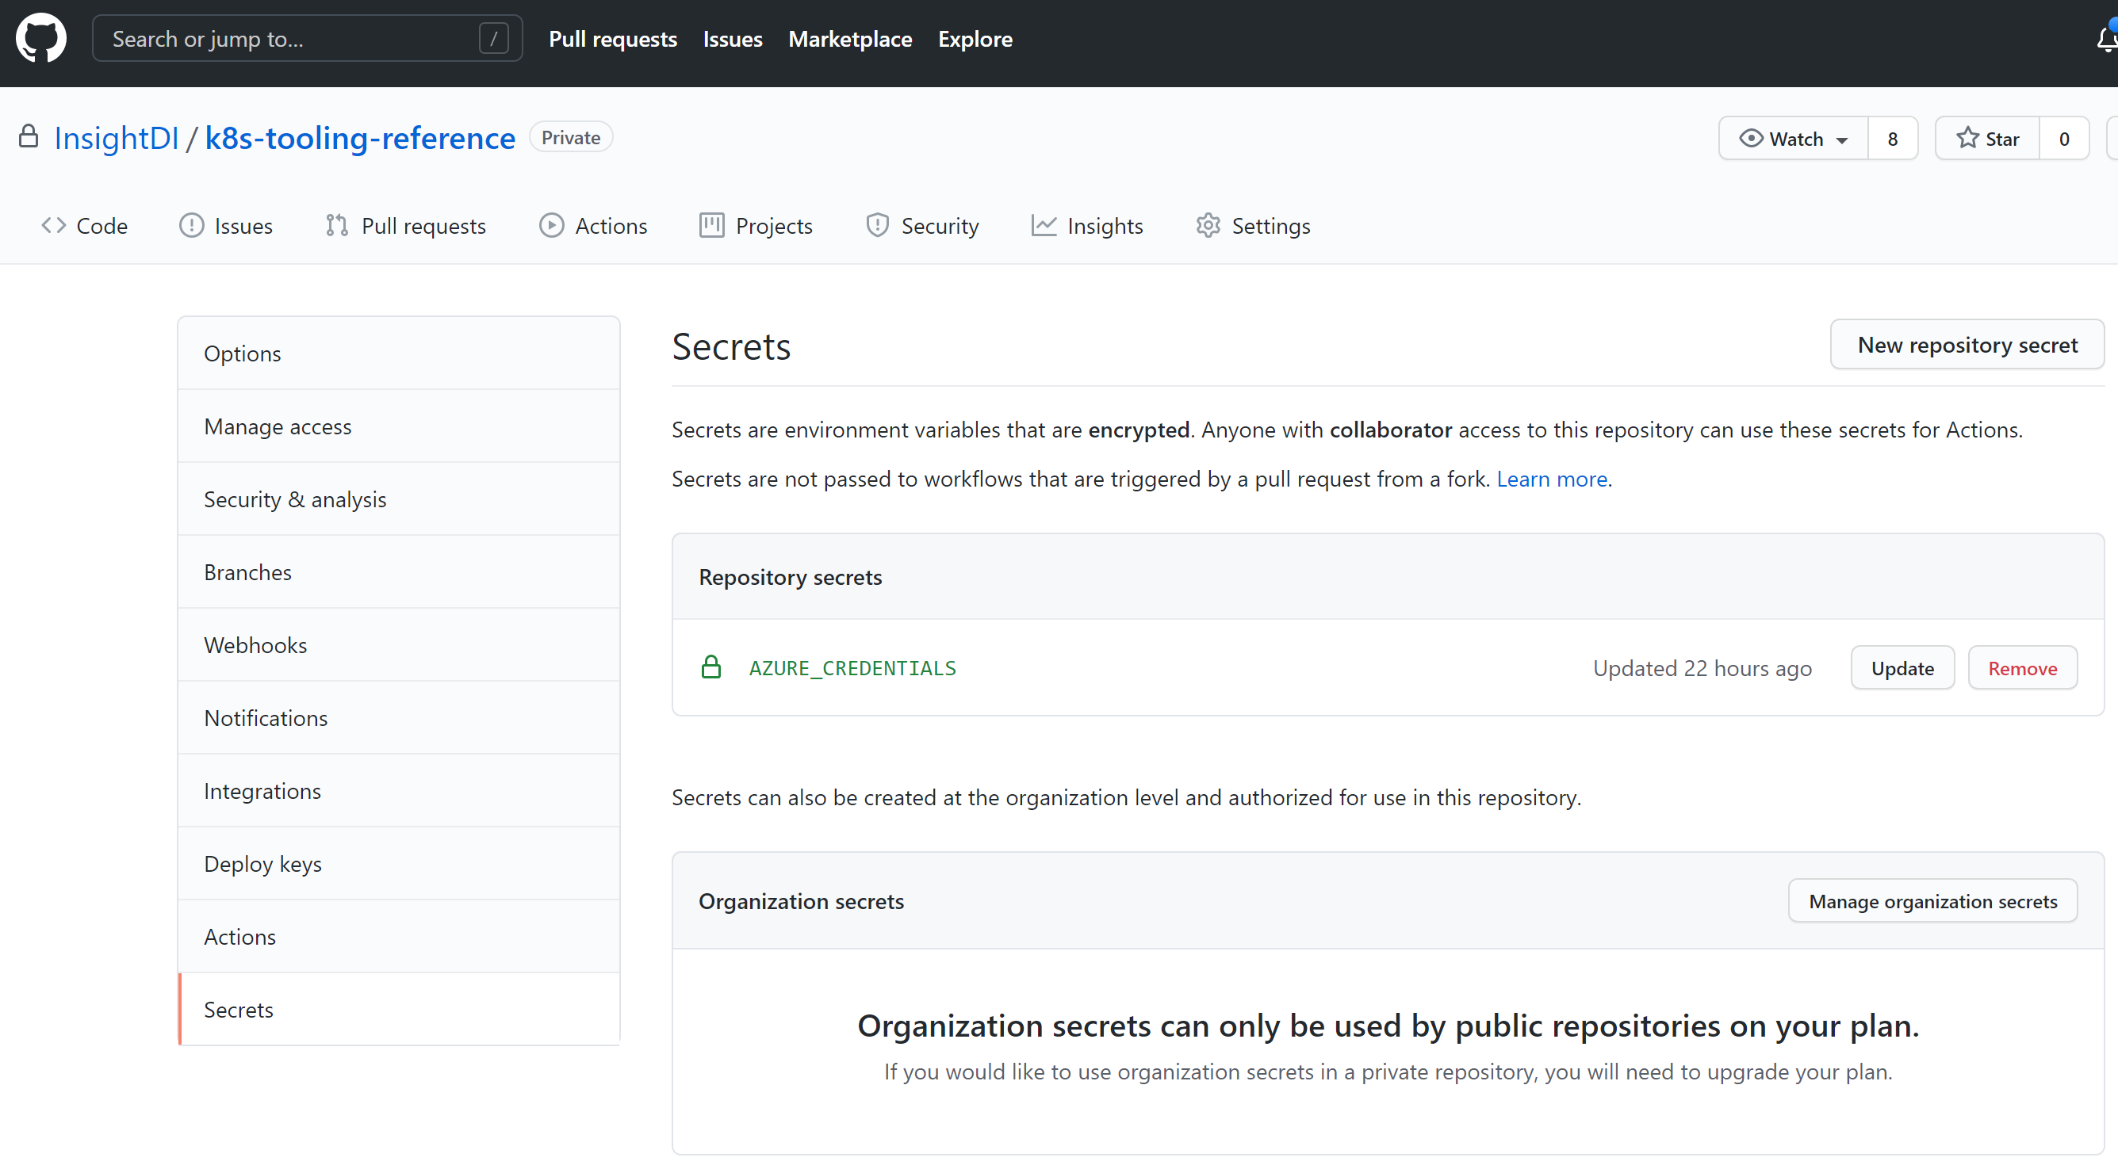
Core GitHub Features
Secrets

Slide 62
Getting Started
Where to go from here?

Slide 63
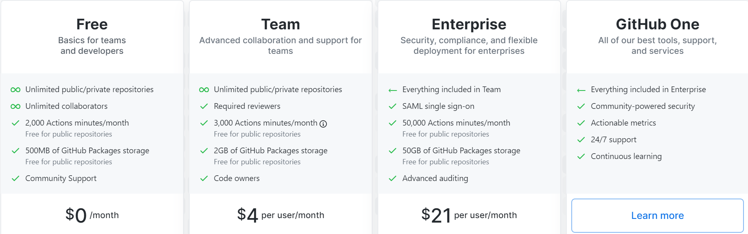
GitHub Tiers
https://github.com/pricing
Notes:
Show the pricing page and note that
Some advanced features are available on the Free tier but only for public repos
Actions minutes and Packages storage increase across the tiers
The enterprise level provides access to GitHub Cloud and on-prem
SSO with Enterprise is a big deal

Slide 64

GitHub Learning Lab!
https://lab.github.com/

Slide 65
Microsoft Acquisition: Looking forward…
The union of feature sets
Azure DevOps
GitHub Enterprise
Azure Repos
Azure Boards
Azure Pipelines/Releases
Azure Artifacts
Azure Test Plans
Azure Wikis
Azure Reporting
Azure Monitor
GitHub Repos
GitHub Projects and Issues
GitHub Actions
GitHub Packages
GitHub Wikis
GitHub Insights
Feature Parity

Slide 66
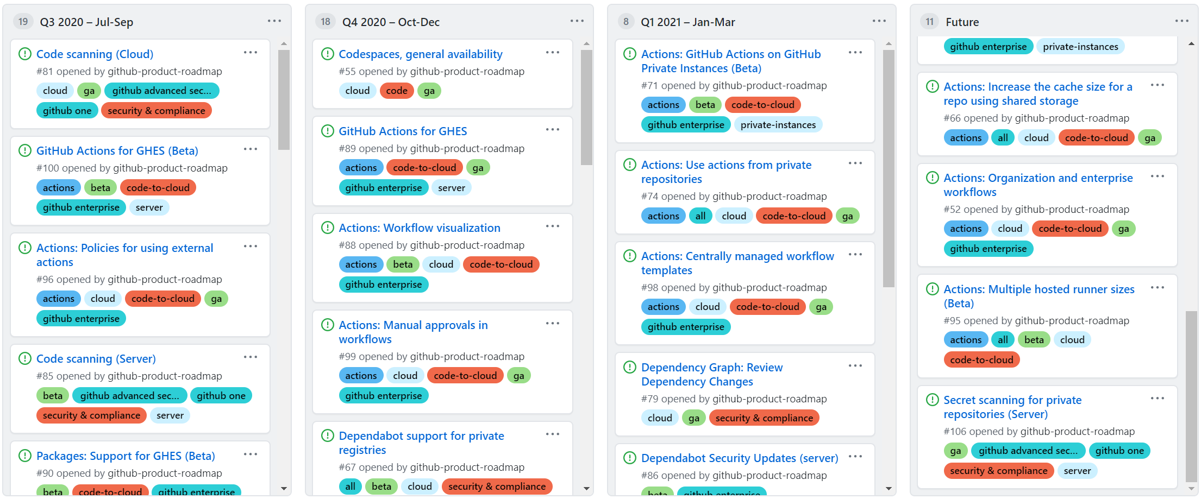
GitHub: Looking Forward
The GitHub Roadmap
https://github.com/github/roadmap/projects
Notes:
Update screenshot

Slide 67
GitHub Lab
Tying it all together!

Slide 68
Thanks for joining us!

